Slide 1



GLOBAL SUSTAINABLE ENERGY
Ajeenkya DY Patil University,Lohegaon
Sahil Bhosale

Slide 2
Problem Statement
BRIEF OVERVIEW:
This case study evaluates trends in electricity access, the availability of clean cooking fuel, renewable energy capacity, and financial flows to developing countries using a comprehensive global sustainable-energy dataset covering the years 2000–2020. In order to find trends, draw attention to regional differences, and pinpoint the nations spearheading the clean energy transition, the study will employ data preprocessing, clustering, and trend analysis techniques. The information produced can help researchers, policymakers, and international organisations create focused plans to reduce gaps in energy access, hasten the adoption of renewable energy sources, and maximise the use of available funds.
Source :
www.freepik.com/

Slide 3
Problem Statement
KEY OBJECTIVES
1. Evaluate Energy Access Progress:
Monitor and contrast global advancements in clean cooking fuel and electricity access, highlighting underdeveloped nations and areas. 2. Assessing Renewable Energy Growth:
To gauge the rate of the clean energy transition, examine the amount of electricity generated by renewable sources per person as well as its proportion of the overall energy mix. 3. Group Countries into Peer Groups:
To facilitate peer-based comparisons and knowledge sharing, group nations with comparable energy profiles using unsupervised learning techniques. 4. Examine the Function of Financial Flows:
Examine how advancements in energy access and renewable capacity are related to global financial assistance. 5. Determine Policy Levers:
Based on data trends and best practices from top nations, suggest methods for quickening progress. 6. Facilitate Decision-Making Based on Data:
Give stakeholders evidence-based guidance so they can prioritise investments, interventions, and cooperative initiatives.

Slide 4
Dataset Overview
Dataset Description:
Rows, Columns: 3,649 rows × 21 columns
Coverage: Year = 2000 – 2020 ; Entities = countries/regions
Key indicators (examples):
1. Access to electricity (% of population)
2. Access to clean fuels for cooking
3. Renewable-electricity-generating-capacity-per-capita
4. Financial flows to developing countries (US $)
5. Electricity from fossil fuels / nuclear / renewables (TWh)
6. Renewable energy share in total final energy consumption (%)
Source: Provided CSV (global sustainable-energy indicators)
Source :
www.freepik.com/

Slide 5
Methodology
Data Import & Inspection:
Load the CSV file and verify the types, columns, and shape (3649×21)
2. Cleaning and Imputation:
Cast Year to numeric; handle nulls in access, capacity, and finance fields.
3. Scaling:
Use StandardScaler on a subset of features for equitable distance-based techniques.
4. Clustering:
Identify peer country groups by running KMeans (k, as determined by elbow/silhouette in development).
5. Trend Modelling:
Fit time-based trends for specific indicators using Polynomial Features + Linear Regression.
6. Evaluation:
Qualitatively report clustering cohesion/separation; examine residuals and RMSE/MAE for regression.
7. Documentation:
Note presumptions, restrictions, and warnings about the data.
Source :
www.freepik.com/

Slide 6
Algorithm Used :
1. Linear Regression:
Could predict something like “Access to electricity (% of population)” based on GDP, population, renewable capacity, etc.
2. Polynomial Regression:
If electricity access grows faster in some regions and slower in others producing a curved trend.
3. Decision Tree Regressor:
Could split countries into “high GDP” vs “low GDP” and then predict electricity access differently for each branch
4. Random Forest Regressor:
More accurate than one tree when predicting renewable capacity per capita from many variables.
5. Gradient Boosting Regressor:
Could capture subtle patterns in how multiple factors influence sustainable energy metrics.
6. K-Means Clustering:
Cluster countries into “High Renewable & High Access”, “Low Renewable & Low Access”, etc.
7. Neural Network (MLP - Multi-Layer Perceptron):
Could model complex interactions between energy, economy, and environmental metrics.

Slide 7

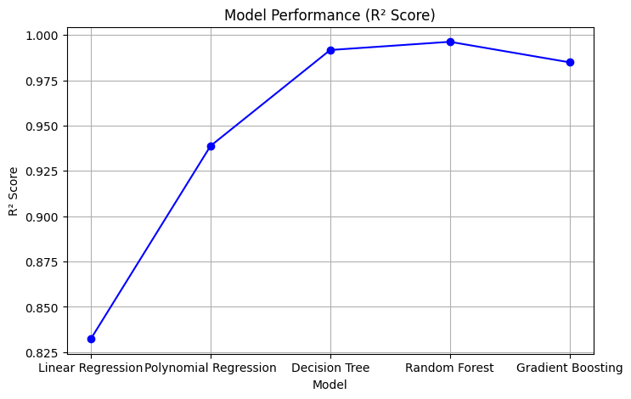
Conclusion
Summary:
Tested 5 models on global sustainable-energy data.
2. Random Forest achieved the highest R² Score.
3. Ensemble methods captured complex, non-linear relationships best.
4. Supports reliable, data-driven forecasting for energy policy
Source :
www.freepik.com/

Slide 8
References
Global sustainable-energy indicators — Provided CSV (project dataset)
2. Analysis & code — My notebook (GDSE code.ipynb in Github Link)
3. Github Link — https://github.com/Sahilll777/Project-DataSci

Slide 9
Thank You
Notes:
Thank You !!

